Slide 1
Linear Models

Slide 2
All Inputs and Target is Efficiency
Target Variable | Input | Weight of Input
Efficiency | Scrap (MT) | 0.2037
 | Sponge (MT) | 0.2907
Metrics | Alloys (MT) | -0.0537
Train NMSE: 81.015 | Previous Voltage | -0.0048
Test NMSE: 153.271 | Previous Frequency | -0.0002
R2: -0.532 | Previous Rating of the Furnace | -0.0048
 | Refractory lining before heating | 0.0269
 | Number of capacitors removed | 0.0105
 | Tapping Temperature | 0.0241

Slide 3
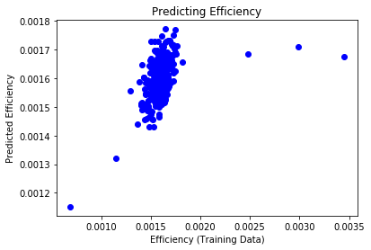
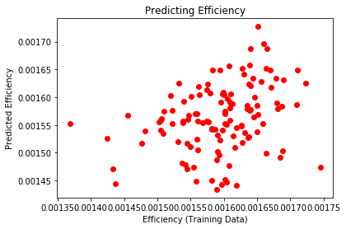
All Inputs and Target is Efficiency

Slide 4
All Inputs and Target is Total Heat Time
Target Variable | Input | Weight of Input
Total Heat Time | Scrap (MT) | 0.1681
 | Sponge (MT) | 0.2370
Metrics | Alloys (MT) | 0.0609
Train NMSE: 90.111 | Previous Voltage | 0.0166
Test NMSE: 75.721 | Previous Frequency | 0.0154
R2: 0.242 | Previous Rating of the Furnace | 0.0166
 | Refractory lining before heating | -0.0792
 | Number of capacitors removed | -0.0476
 | Tapping Temperature | 0.0782

Slide 5
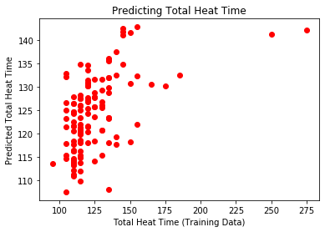
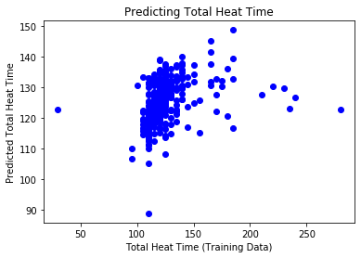
All Inputs and Target is Total Heat Time

Slide 6
All Inputs and Target is Voltage
Target Variable | Input | Weight of Input
Voltage | Scrap (MT) | -0.1701
 | Sponge (MT) | -0.1529
Metrics | Alloys (MT) | -0.0673
Train NMSE: 20.502 | Previous Voltage | 0.3255
Test NMSE: 15.240 | Previous Frequency | -0.1885
R2: 0.847 | Previous Rating of the Furnace | 0.3255
 | Refractory lining before heating | 0.2396
 | Number of capacitors removed | 0.2159
 | Tapping Temperature | -0.0599

Slide 7
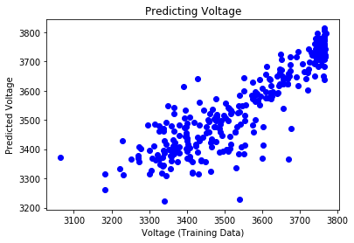
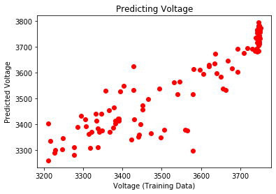
All Inputs and Target is Voltage

Slide 8
All Inputs and Target is Frequency
Target Variable | Input | Weight of Input
Frequency | Scrap (MT) | 0.2527
 | Sponge (MT) | 0.2787
Metrics | Alloys (MT) | 0.0331
Train NMSE: 3.117 | Previous Voltage | -0.0144
Test NMSE: 4.140 | Previous Frequency | 0.3635
R2: 0.958 | Previous Rating of the Furnace | -0.0144
 | Refractory lining before heating | -0.0789
 | Number of capacitors removed | 0.4047
 | Tapping Temperature | -0.0273

Slide 9
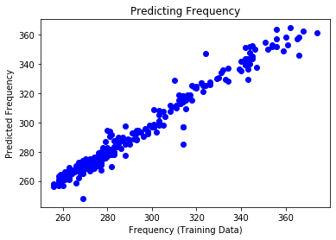
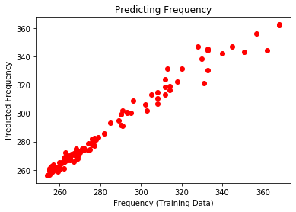
All Inputs and Target is Frequency

Slide 10
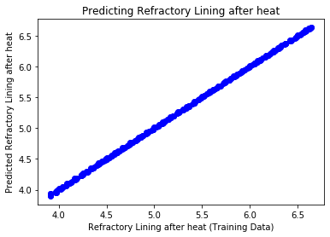
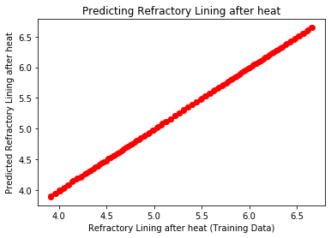
All Inputs and Target is Refractory Lining after heat

Slide 11
Non-linear Models

Slide 12
All Inputs and Target is Efficiency
Target Variable | Input
Efficiency | Scrap (MT)
 | Sponge (MT)
 | Alloys (MT)
 | Input energy previous (KWH)
Metrics | Total Heat Time previous (minutes)
Train NMSE: 9.187 | Previous Voltage
Test NMSE: 225.540 | Previous Frequency
R2: -1.255 | Previous Rating of the Furnace
 | Refractory lining before heating
 | Number of capacitors removed
 | Tapping Temperature

Slide 13
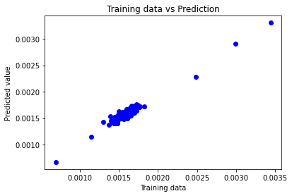
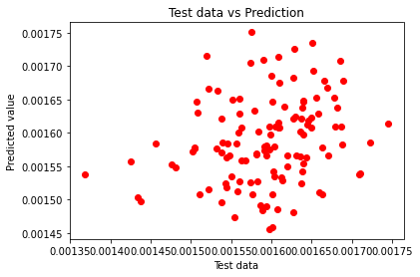
All Inputs and Target is Efficiency

Slide 14
All Inputs and Target is Total Heat Time
Target Variable | Input
Total Heat Time | Scrap (MT)
 | Sponge (MT)
 | Alloys (MT)
 | Input energy previous (KWH)
Metrics | Total Heat Time previous (minutes)
Train NMSE: 8.324 | Previous Voltage
Test NMSE: 179.659 | Previous Frequency
R2: -0.796 | Previous Rating of the Furnace
 | Refractory lining before heating
 | Number of capacitors removed
 | Tapping Temperature

Slide 15
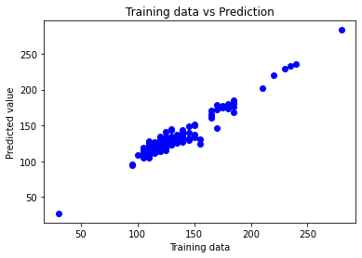
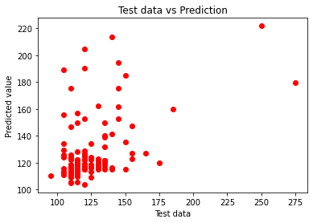
All Inputs and Target is Total Heat Time

Slide 16
All Inputs and Target is Voltage
Target Variable | Input
Voltage | Scrap (MT)
 | Sponge (MT)
 | Alloys (MT)
 | Input energy previous (KWH)
Metrics | Total Heat Time previous (minutes)
Train NMSE: 1.418 | Previous Voltage
Test NMSE: 20.815 | Previous Frequency
R2: 0.791 | Previous Rating of the Furnace
 | Refractory lining before heating
 | Number of capacitors removed
 | Tapping Temperature

Slide 17
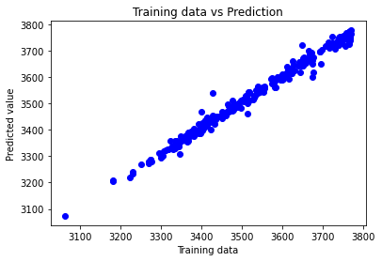
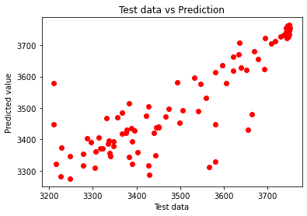
All Inputs and Target is Voltage

Slide 18
All Inputs and Target is Frequency
Target Variable | Input
Frequency | Scrap (MT)
 | Sponge (MT)
 | Alloys (MT)
 | Input energy previous (KWH)
Metrics | Total Heat Time previous (minutes)
Train NMSE: 0.438 | Previous Voltage
Test NMSE: 2.661 | Previous Frequency
R2: 0.973 | Previous Rating of the Furnace
 | Refractory lining before heating
 | Number of capacitors removed
 | Tapping Temperature

Slide 19
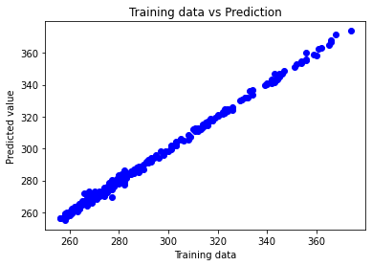
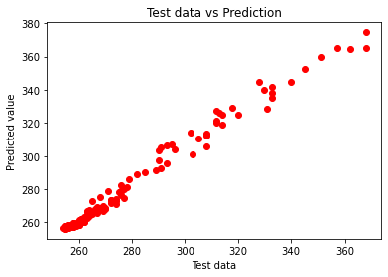
All Inputs and Target is Frequency

Slide 20
All Inputs and Target is Refractory lining after heat
Target Variable | Input
Refractory lining after heat | Scrap (MT)
 | Sponge (MT)
 | Alloys (MT)
 | Input energy previous (KWH)
Metrics | Total Heat Time previous (minutes)
Train NMSE: 0.183 | Previous Voltage
Test NMSE: 0.508 | Previous Frequency
R2: 0.994 | Previous Rating of the Furnace
 | Refractory lining before heating
 | Number of capacitors removed
 | Tapping Temperature

Slide 21
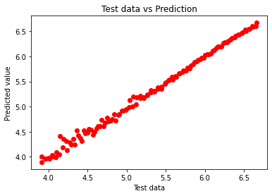
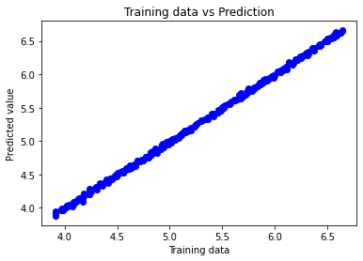
All Inputs and Target is Refractory lining after heat

